Slide 1
PROJECT TITLE :- PSCS235 A one Stop Solution focusing on Tourism
PIP2001 Capstone Project
Review-0
Batch Number: CIT-G06
Student Name | Roll Number
Puneeth N | 20221LIN0004
Rohan Gowda A | 20221LIN0003
Ajin V Joseph | 20221LIN0007
Under the Supervision of,
Dr Shanthi S
Assistant Professor
School of Computer Science and Engineering
Presidency University
Name of the Program: Btech CSE(IoT)
Name of the HoD: Dr. Anandaraj S P
Name of the Program Project Coordinator: Dr. Sharmasth Vali Y
Name of the School Project Coordinators: Dr. Sampath A K / Dr. Abdul Khadar A / Mr. Md Ziaur Rahman

Slide 2
Content
Problem Statement
Analysis of Problem Statement
Timeline of the Project
References

Slide 3
Problem Statement Number: PSCS 235
Organization: Yamaha Motors Solutions
Category (Hardware / Software / Both) :Software
Problem Description : In today's world people travel a lot to different cities and countries . But it is hard for them to travel in the city without prior knowledge . This is the prior motive behind making this app. A lot of websites and apps exist that do the similar job. An app exists that can book hotels , another for booking cabs , another for booking shows , events etc but what we want to do is to integrate all of this into one app in order to save time of the user. Similar apps do exist but they are not very efficient and are very time consuming . We aim to build an app that is user friendly and easy to use and will help people find out what they are looking for in a easier and time efficient way.
Difficulty Level: Simple

Slide 4
Analysis of Problem Statement
A one Stop Solution focusing on Tourism Includes:-
Responsible tourism
Sustainability accounting
Cheap flights
Carrying capacity
Limits of acceptable change
De-marketing
Reducing demand in peak periods

Slide 5
Analysis of Problem Statement (contd...)
Software and Requirements:
Visual Studio
IDE for Android app development.
Mongo DB for Data Base
Xamarin

Slide 6
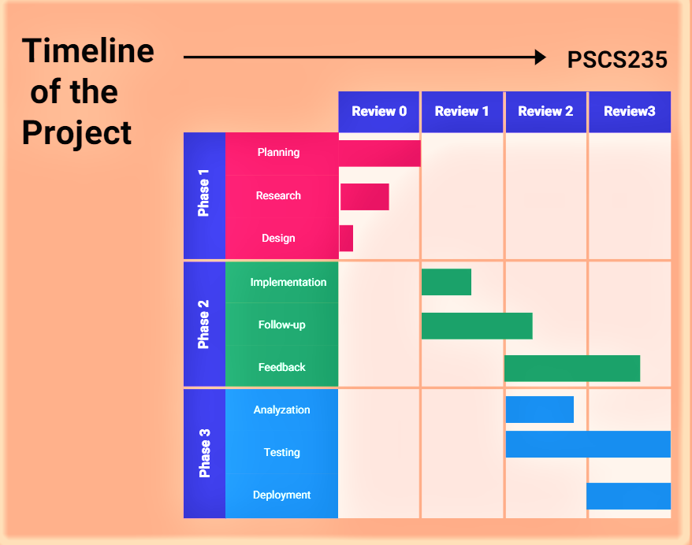
Timeline of the Project (Gantt Chart)

Slide 7
References (IEEE Paper format)
https://www.responsibletravel.com/copy/overtourism-solutions
https://pro.regiondo.com/blog/innovative-tourism
https://github.com/Puneetn21/PSCS235-CIT-G06 (GitHub repository)

Slide 8


